Slide 1

Principles of Web Design 6th Edition
Chapter 3 – Site Planning

Slide 2
Objectives
Understand the web site development process
Create a site specification
Identify the content goal
Analyze your audience
Build a web site development team
Create conventions for filenames and URLs
Set a directory structure
Create a site storyboard
Publish your web site
Test your web site

Slide 3
Understanding the Web Site Development Process
You need a good project plan
Larger projects need a project manager
Adopt a development framework
The project life cycle encompasses the entire project from start to finish

Slide 4
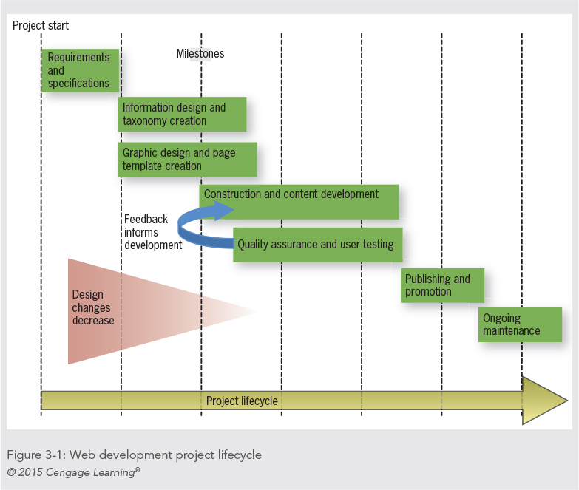

Slide 5
Requirements and Specifications
The client presents the requirements for the site
Requirements are the list of customer needs
The project team breaks the requirements down to tasks
The team prepares a project specification that contains:
Page layout sketches
Audience definition
Technical requirements

Slide 6
Information Design and Taxonomy Creation
User analysis guides the design of site content
Goal is to create meaningful content navigation
Taxonomy is a classification and naming of contents in a hierarchy
The taxonomy of the site structures the topic hierarchy and navigation

Slide 7
Graphic Design and Page Template Creation
Designers prepare sketches and page mockups to represent page layouts
All page layouts start with a mockup
Mockups can be easily edited based on feedback
Wireframes document a more stable page design
Wireframes offer a more complete view of what the final design will look like

Slide 8
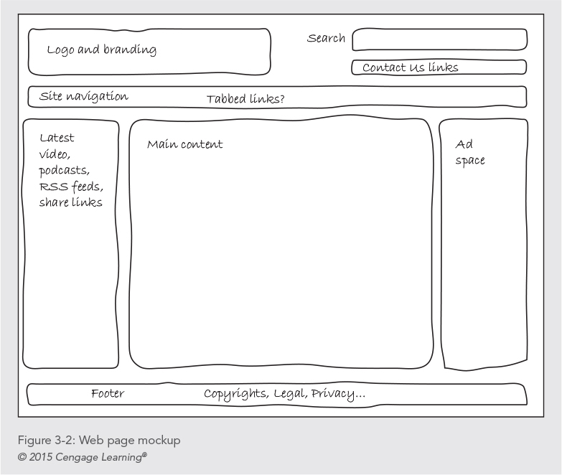

Slide 9
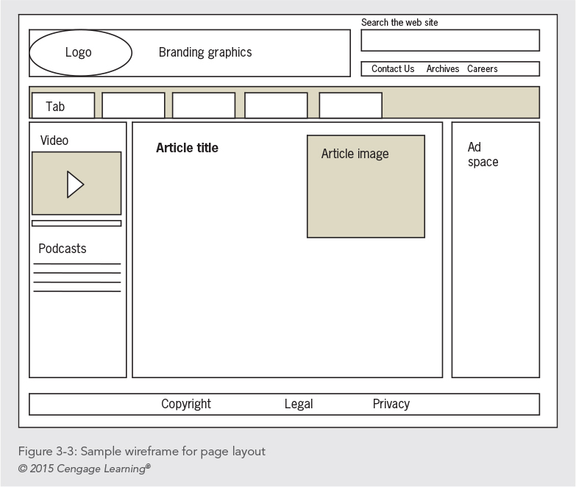

Slide 10
Construction and Content Development
Construction begins when the design stage is mostly complete
This stage includes technical development of the site
Some testing will occur during this stage

Slide 11
Quality Assurance and User Testing
Quality assurance validates the technology of the site
User testing validates the design
Cross-platform testing and usability testing ensure users can access content easily

Slide 12
Publishing and Promotion
The site is published to the web
Promotion of the site begins

Slide 13
Ongoing Maintenance
Starts when the site goes live and continues throughout the life of the project
Keeping content fresh is vital

Slide 14
Creating a Site Specification
Who is the client for the site?
Can you write a two- or three-paragraph mission statement that briefly states the site’s goals?
What do you envision as the goal of the site?
What do you (or your company or organization) hope to gain from creating and maintaining a web site?
What are the requirements for the web site?

Slide 15
Creating a Site Specification
Are the requirements feasible?
How will you judge the success of the site?
Who is the target audience?
What are the limiting technical factors?
What is the budget?
Is this a new site or an upgrade?

Slide 16
Identifying the Content Goal
Examine closely what type of site you are building
Your objectives and your users’ objectives may be quite different
Adopt your users’ perspective
Think about the type of content you’re presenting and look to the web for examples of how best to present it

Slide 17
Identifying the Content Goal
Types of web sites:
Billboard
Publishing
Portal
Special interest
Blog
Social networking

Slide 18
Identifying the Content Goal
Types of web sites:
Wikis
RSS
Virtual gallery
E-commerce, catalog, online shopping
Product support
Intranet/Extranet

Slide 19
Analyzing Your Audience
Produce an audience definition:
What is it that users want when they come to your site?
How can you attract them and entice them to return for repeat visits?
What type of computer and connection speed do your typical visitors have?

Slide 20
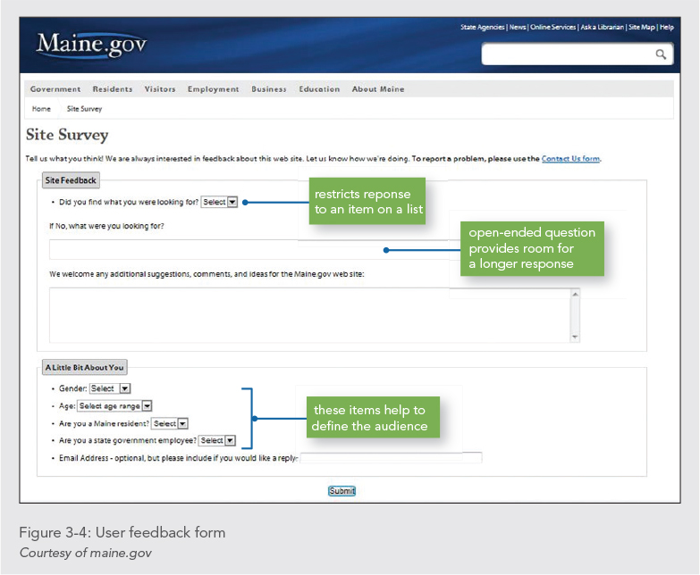

Slide 21
Analyzing Your Audience
Who are the typical members of your audience?
Are they male or female?
What level of education do they have?
What is their reading and vocabulary level?
What level of technical aptitude do they have?
Why do people come to your site?
Do they want information?
Do they want to download files?
Are they looking for links to other web sites?

Slide 22
Using Web Analytics
Web analytics are statistics gathered by web servers
Reporting tools can analyze the statistics
You can track user activity on your web site
You can see where your visitors come from and which pages they like the best

Slide 23
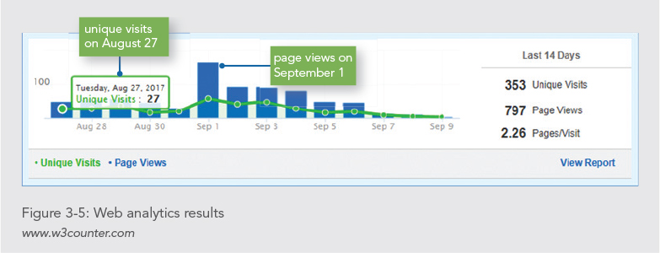

Slide 24
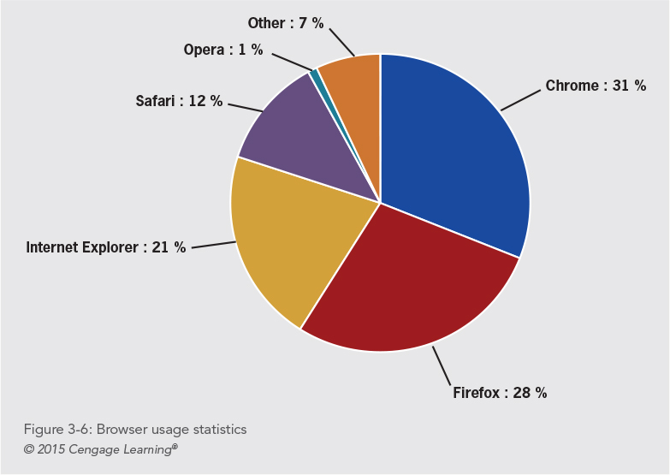

Slide 25
Identifying Technology Issues and Accessibility Constraints
Think about where users are geographically located and what their technology level might be
Test in different environments and with different technologies
Consider the physical capabilities of your users

Slide 26
Identifying Technology Issues and Accessibility Constraints
Identify accessibility constraints
Review the WCAG 2.0 and section 508 guidelines
In new sites, plan for accessibility
In existing sites, assess the current accessibility
Look to other real-life accessibility implementations

Slide 27
Identifying Software Tools
Try to use software that matches the complexity needs of your site
Move up to more advanced tools as your skills grow
Learn to use graphics tools as well
Look to shareware and freeware options

Slide 28
Building a Web Site Development Team
Project managers
HTML developers
Designers
Writers and information designers
Application developers
Database administrators
Server administrators

Slide 29
Naming Files
File naming conventions vary across operating systems
The ISO 9660 standard works across all operating systems
Leave out special characters
Use the correct file extensions
Use underscores instead of spaces
Use all lowercase letters

Slide 30
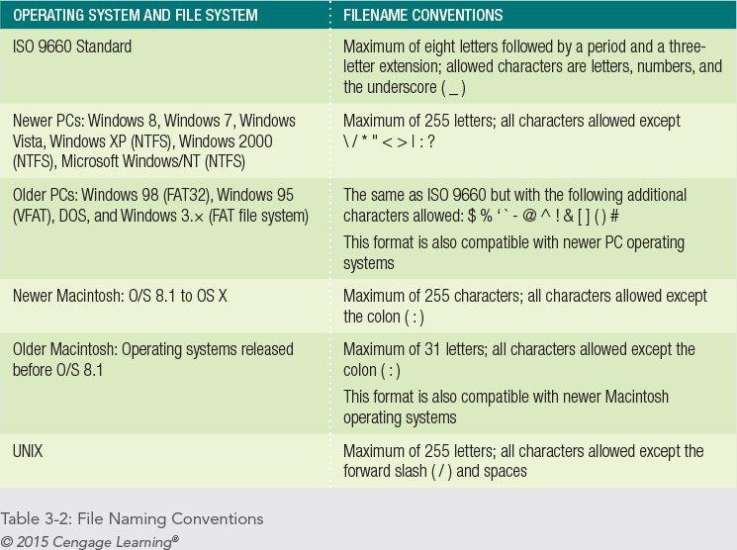
Unix is a case sensitive operating system.

Slide 31
Choosing the Correct File Naming Conventions
Filenames should work across all operating systems.
Don’t use spaces in your filenames; use underscores instead. Instead of about web design.html, use about_web_design.html
Avoid all special characters. Stick to letters, numbers, dashes, and underscores
Use all lowercase letters for your filenames

Slide 32
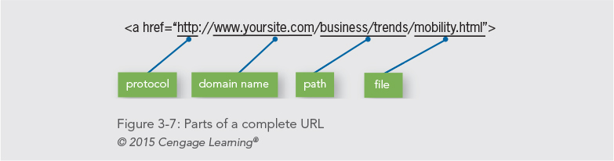
Using Complete or Partial URLs
Complete URLs are the unique address of a file on the web

Slide 33
Using Complete or Partial URLs
Partial URLs locate a file that resides on your own computer or server
<a href=“mobility.htm">link text</a>

Slide 34
Setting a Directory Structure
You build a site on a development computer but host it on a different computer
The files for your web site must be transferred from the development computer to the hosting computer
Your file structure must be transferable
Use relative paths to indicate file locations

Slide 35
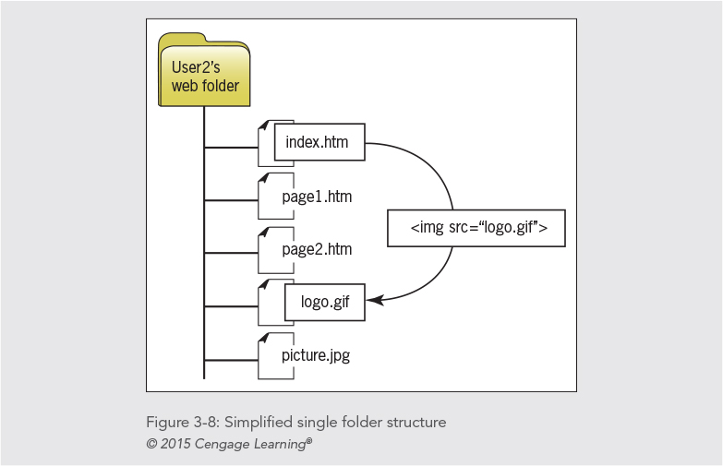
Single Folder Structure

Slide 36
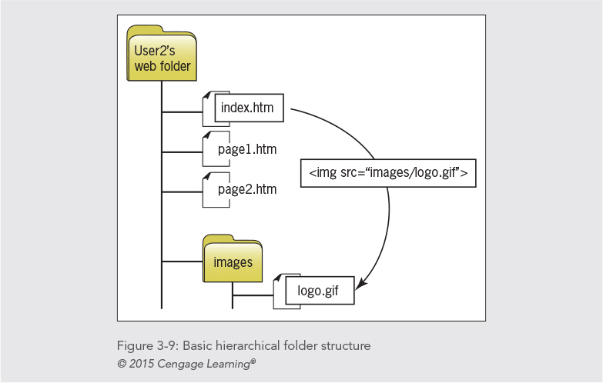
Hierarchical Folder Structure

Slide 37
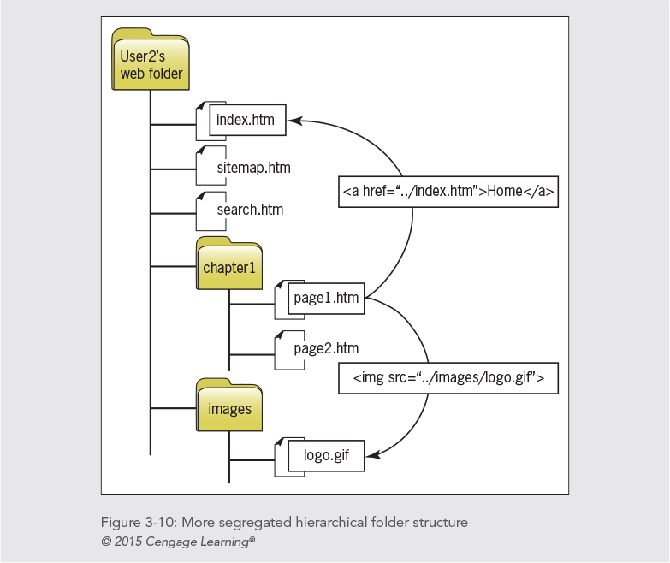
Segregated Hierarchical Structure

Slide 38
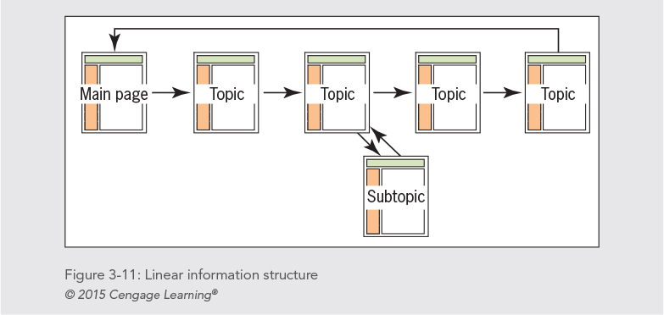
Linear Structure
It guides the user along a straightforward path.
Book-like presentation

Slide 39
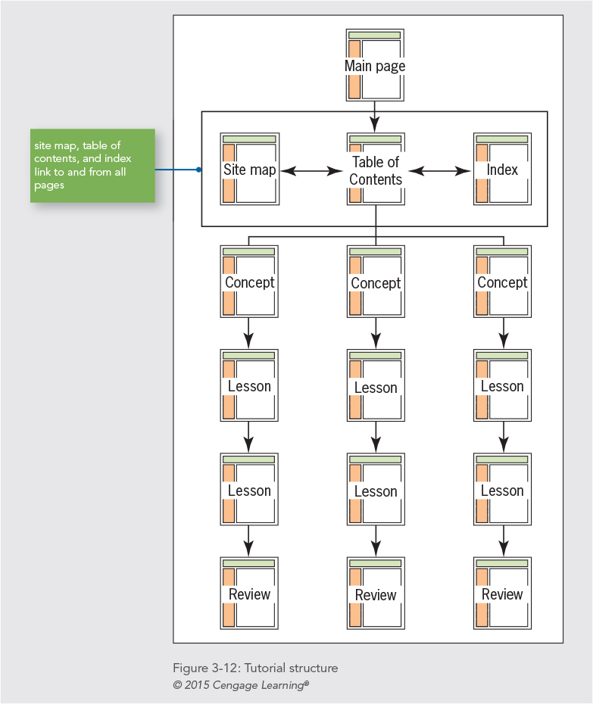
Tutorial Structure
It is perfect for computer-based training content such as tutorials procedures.
users can leave the lesson structure and return at any time (hypertext).
table of contents, index, and site map pages are linked to—and from—all pages in the site.

Slide 40
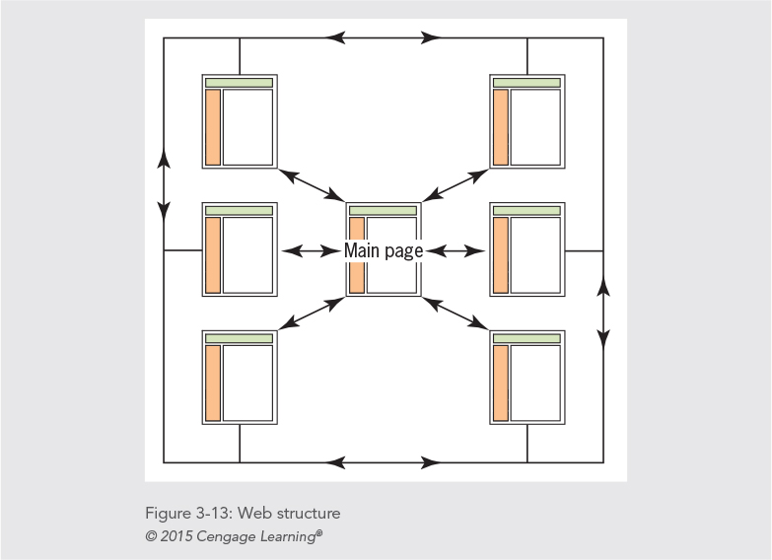
Web Structure
Nonlinear : browsing freely.
Needs standardized navigation bar.

Slide 41
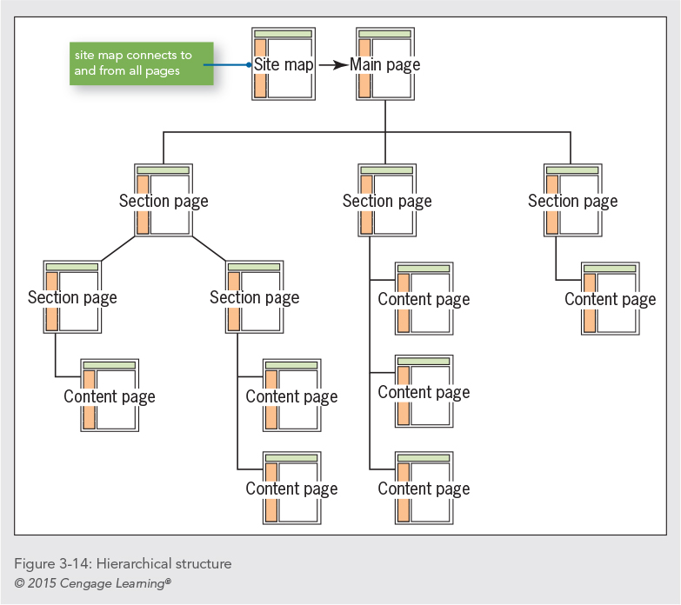
Hierarchical Structure
The most information design.
The section pages break up and organize the content at different levels throughout the site.
Navigation is primarily linear within the content sections.

Slide 42
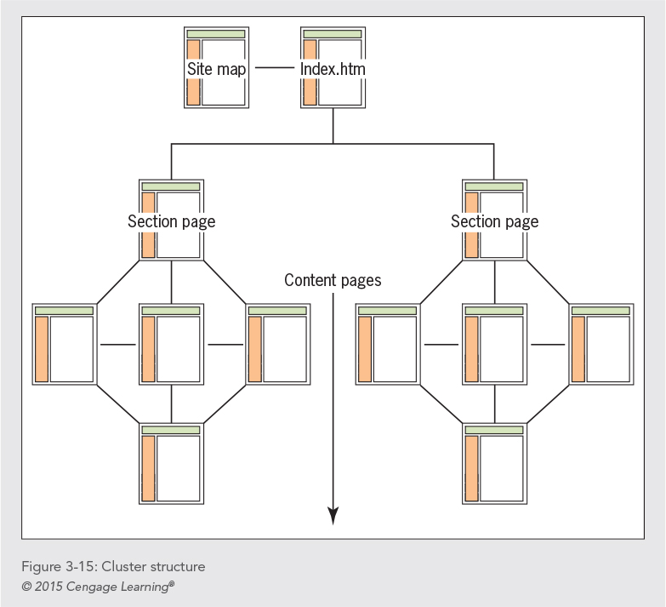
Cluster Structure
It is similar to the hierarchical structure, except that every topic area is an island of information.
All pages contain a navigation bar with links to the section pages, main page, and site map.

Slide 43
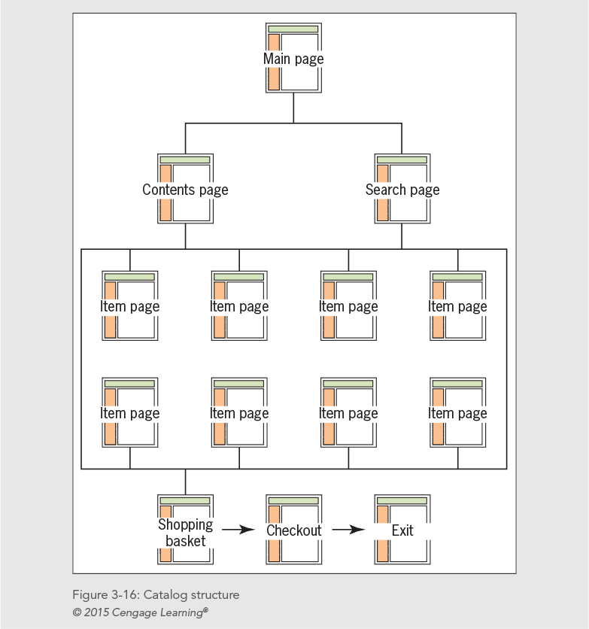
Catalog Structure
It is ideally suited to online shopping.
The user can browse or search for items.
The user can add/drop items to shopping carts.
Then they review items then checkout.
The site Processes payments using credit cards, shopping cards, etc..

Slide 44
Choosing a Web Hosting Service Provider
The web hosting service hosts your web site
Select a web hosting service appropriate to the size of your web site
Check for the following features
Accessible technical support
E-mail addresses
SQL database support
Secure socket layer support

Slide 45
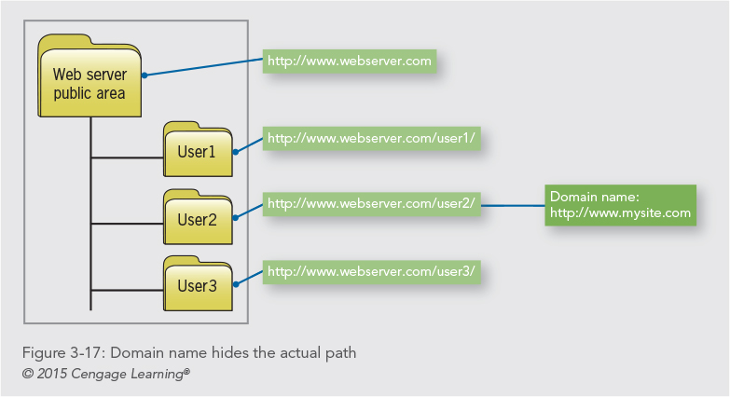
Registering a Domain Name

Slide 46
Web Hosting Service Comparison Checklist
Is the web host local or national?
What are the details of the different hosting packages?
Are there bandwidth limits for the number of visitors your site receives per month?
Does the web host offer technical support?
How many e-mail addresses do you get?
Does the web host provide software and offer support for the latest connection technologies?
Does the web host offer enhanced services?

Slide 47
Uploading Your Files with FTP
To publish pages on the web, you must send your HTML code, images, and other files to the web server
FTP software let you transfer the files
Some HTML-editing software has built-in FTP
There are many shareware and freeware FTP programs to choose from

Slide 48
Testing Your Web Site
Multiple browsers
Multiple operating systems, devices
Connection speeds
Display types
Link testing

Slide 49
Usability Testing
Vary your subjects
Formalize your testing
Develop a feedback form

Slide 50
Feedback Questions
Did you find the information you needed?
Was it easy or difficult to access the information you needed?
Did you find the web site visually attractive?
Did you find the content easy to read?
Did you find the web site easy to navigate?
Did you think the information was presented correctly?
Did the information have enough depth?
What area of the web site did you like the best? Why?
What area of the web site did you like the least? Why?
Would you recommend the web site to others?

Slide 51
Summary
A successful web site is the result of careful planning
Become familiar with the web development lifecycle
Start with pencil and paper
Write a site specification document
Identify the content goal
Analyze your audience
An effective site is a team effort

Slide 52
Key terms
Secure Socket Layer (SSL)—Communications software that allows transmission of encrypted secure messages over the Internet.
Uniform Resource Locator (URL)—The global address of documents and other resources on the web.
web analytics—The analysis of statistics that are gathered by web servers.
web server—A computer connected to the Internet that runs server software. The software lets the computer use the Hypertext Transfer Protocol (HTTP) to serve HTML files to web browser clients.

Slide 53
Summary
Create portable filename conventions
Create an information structure for your site
Shop carefully when seeking a web host
Learn to use FTP software
Test, test, test!

